Slide 1
3x3 First Layer Cross and Corners
COLL 134
Week 2

Slide 2
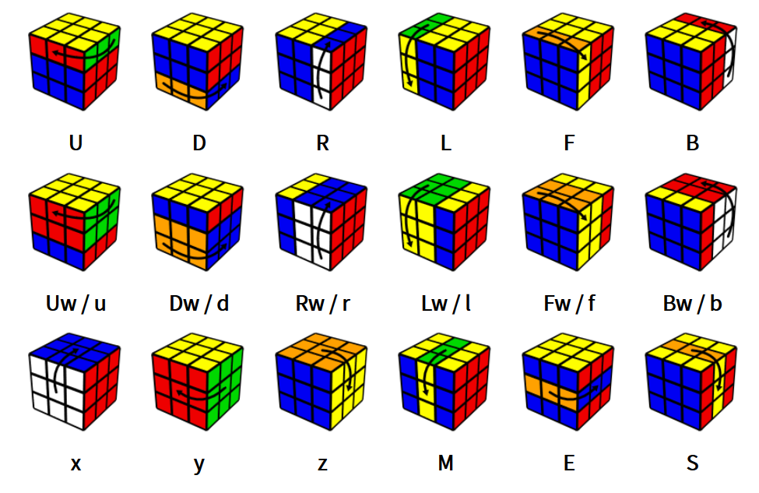
Notation Review
jperm.net

Slide 3
Idea
Solve cube in layers, moving from one face to the opposite face
For instructional purposes, we always start solving on white
Solving a face is NOT the same as solving a layer
No specific notation or algorithms for first layer
First layer should be solved intuitively

Slide 4
First Layer Cross
Solve all 4 edge pieces of first layer
Create X or + shape surrounding white center
Remember each edge piece = 2 colors
White colors match white center, other colors match corresponding centers
For beginners, usually 10-15 moves total (~3-5 moves per edge piece)
For advanced speedsolvers, usually ~5 moves total

Slide 5
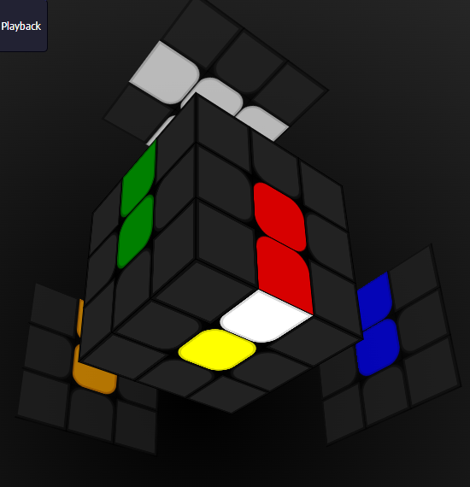
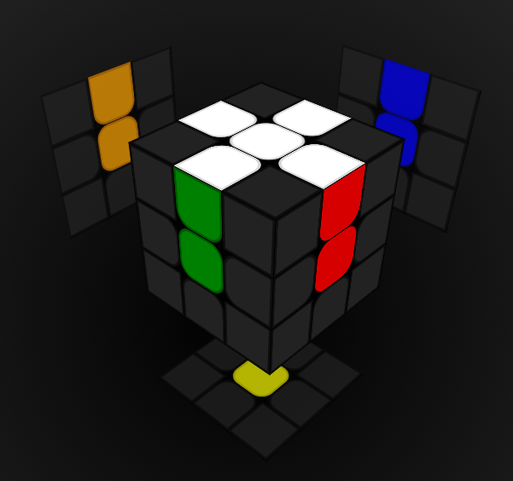
First Layer Cross
General Concept
Hold cube with white center up
Top layer is “target” layer
Bottom layer is “working” layer
Assuming edge piece on bottom layer, align non-white color with corresponding center
Bring edge piece to top layer via 180° turn

Slide 6
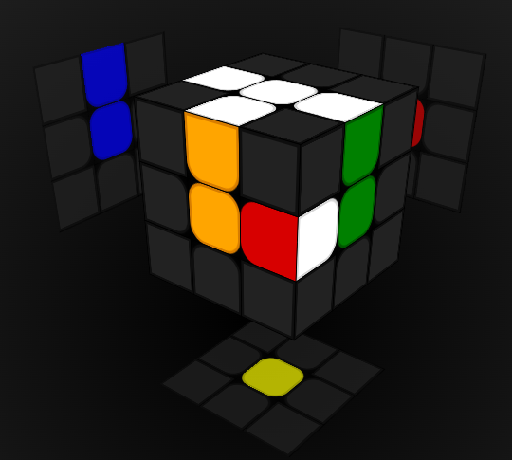
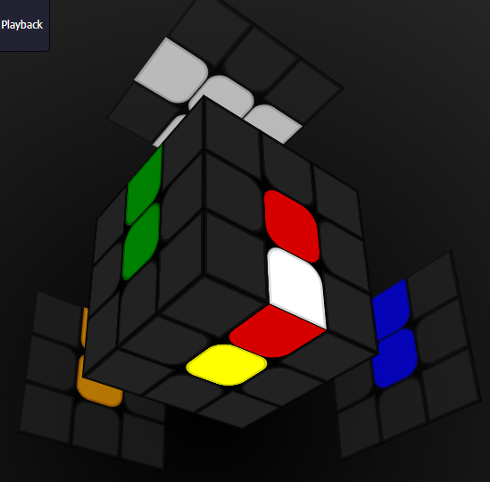
First Layer Cross Cases
What if edge piece is connected to another edge piece which has already been solved?
What if edge piece is on bottom layer but orientation is flipped?
vs.
e.g.

Slide 7
First Layer Corners
Solve all 4 corner pieces of first layer
White face should now be complete
Solid bars of color adjacent to white face
For beginners, usually 15-25 moves (~3-7 moves per corner piece)
Advanced speedsolvers do not solve first layer corners independently

Slide 8
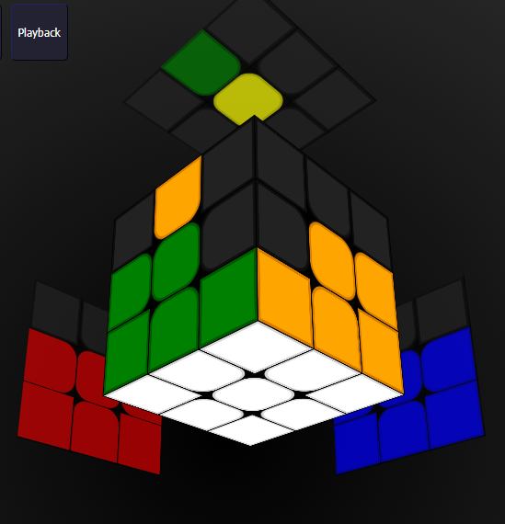
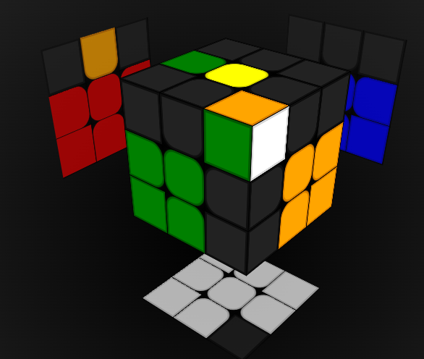
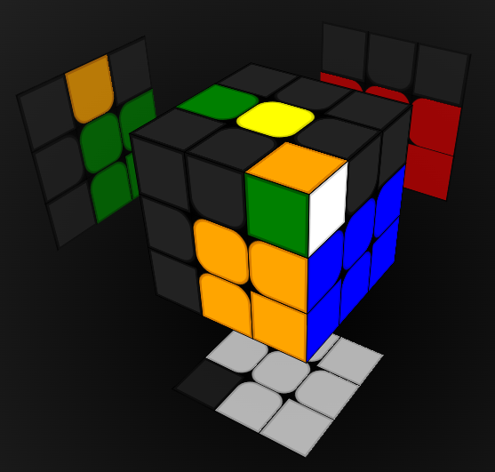
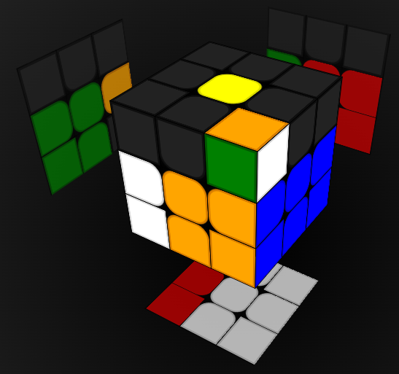
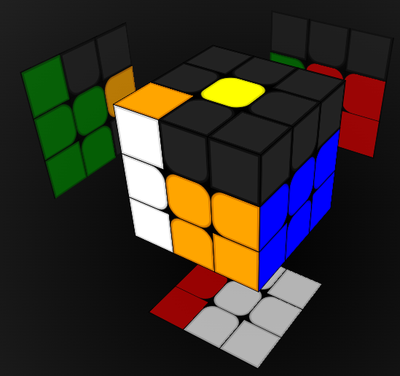
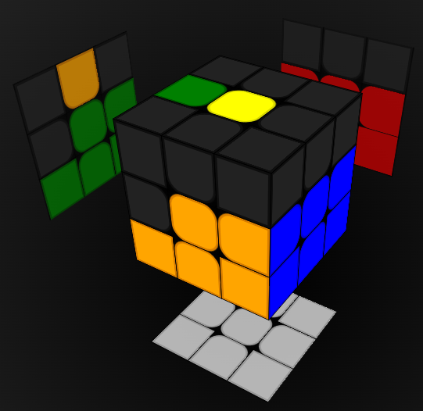
First Layer Corners
General Concept
Rotate cube so cross is facing down
Bottom layer becomes “target” layer
Top layer becomes “working” layer
Insertion
Assuming white color of corner piece is NOT facing up, move corner away from target slot
Bring target slot up into working layer
Return target slot to target layer
Align white colors

Slide 9
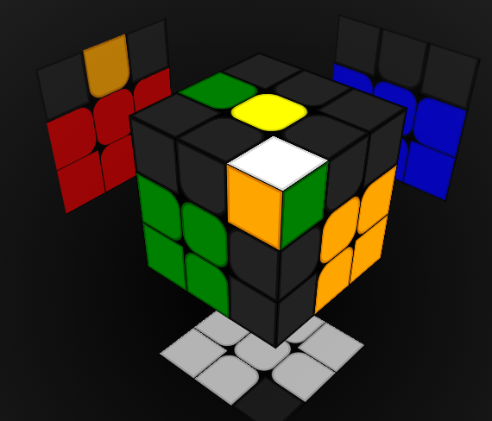
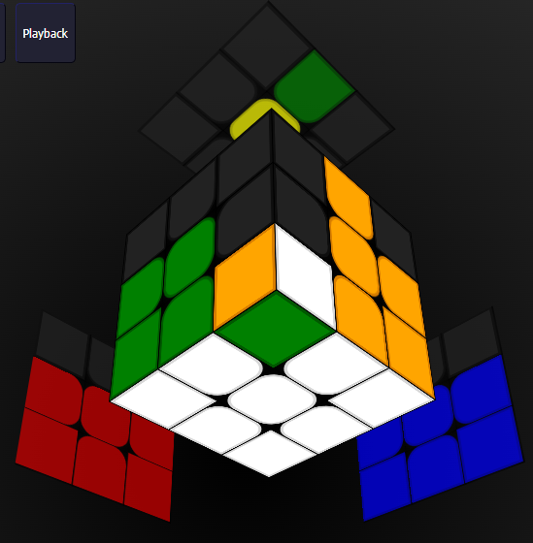
First Layer Corners Cases
What if white color of corner piece is facing up?
What if corner piece is already inserted, but in wrong orientation?
e.g.
e.g.

Slide 10
Tips
Consistent grip
Cross/edges – white face up
Corners – white face down
Focus on one piece at a time
No multitasking (this is for later weeks!)

